Slide 2
Type your answer here
Type your answer here

Slide 3
Type your answer here
Type your answer here

Slide 4
Type your answer here
Type your answer here
Type your answer here

Slide 5
Type your answer here

Slide 6
Type your answer here
Type your answer here

Slide 7
Type your answer here
Type your answer here

Slide 8
Type your answer here
Type your answer here

Slide 9

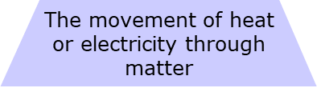
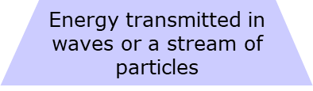

Slide 10
Type your answer here

Slide 11
Type your answer here

Slide 12
Type your answer here

Slide 13
Type your answer here

Slide 14
Conduction
Convection
Radiation
Conduction
Convection
Radiation
Conduction
Convection
Radiation
Conduction
Convection
Radiation
Conduction
Convection
Radiation
Conduction
Convection
Radiation

Slide 15
Type your answer here

Slide 16
Type your answer here
Type your answer here
Type your answer here
Type Here
Type Here
Type Here
Type Here

Slide 17
Type your answer here
Notes:
Clear up any confusion and answer questions.

Slide 18
Type your answer here

